Slide 1
Check-In C5 Review: Syntactic Ambiguity
Expr ⟶ Expr plus Expr Expr ⟶ Term Term ⟶ Term times Term Term ⟶ Factor Factor ⟶ intlit
Add parentheses to this grammar. The new rule(s) should maintain implicit precendence, but allow parens that can override it. Also, make the grammar unambiguous.
Does this change whether the grammar is left-recursive, right-recursive, or recursive?

Slide 2
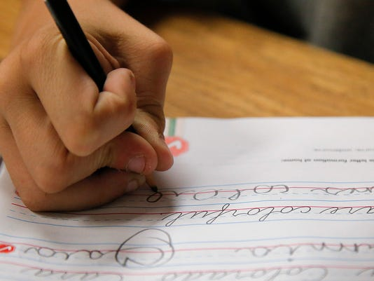
Administrivia
On Written Work…
Sorry for the confusion!
If you attend class when a written work is due, you DO NOT have to turn it in

Slide 3
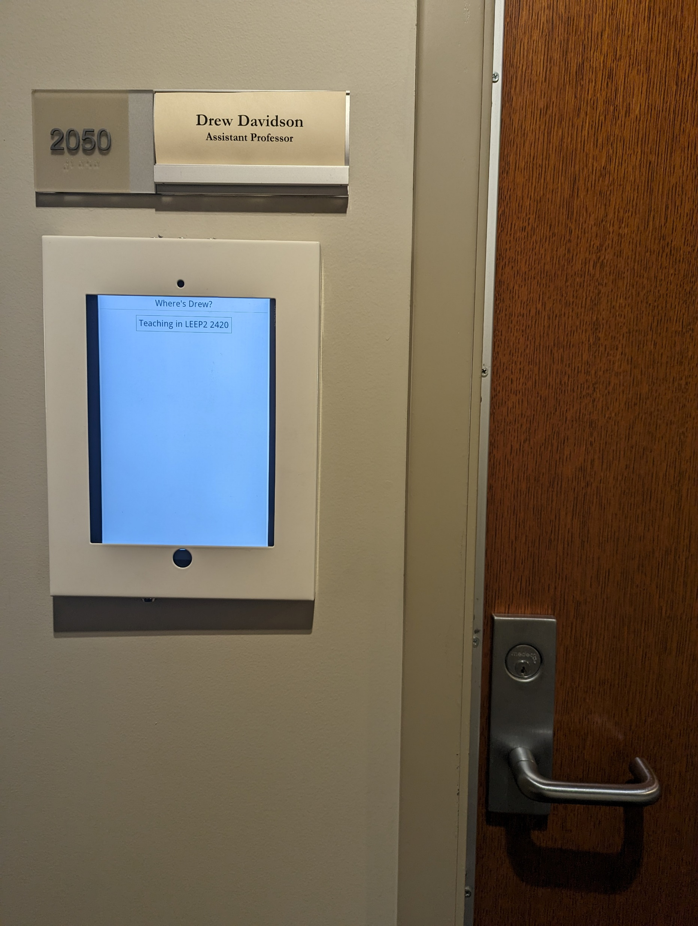
Administrivia
Behold: The Drew Positioning System
https://drew.davidson.cool/where

Slide 4
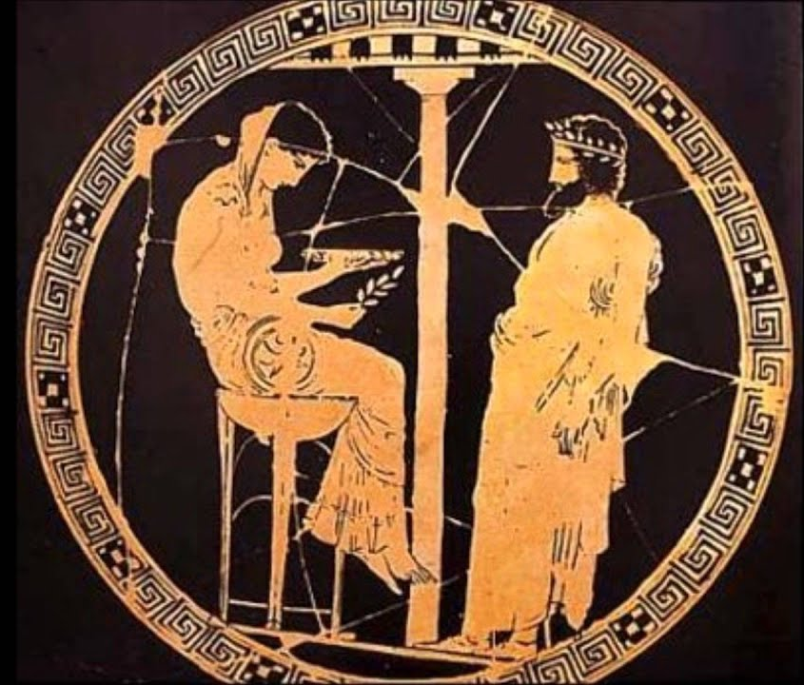
Administrivia
Behold: The Project Oracle!
https://compilers.cool/oracles/o1
What’s the format of output <x> ?
Submit input to the Oracle
What’s the token for character <y> ?
- Submit y to the Oracle

Slide 5
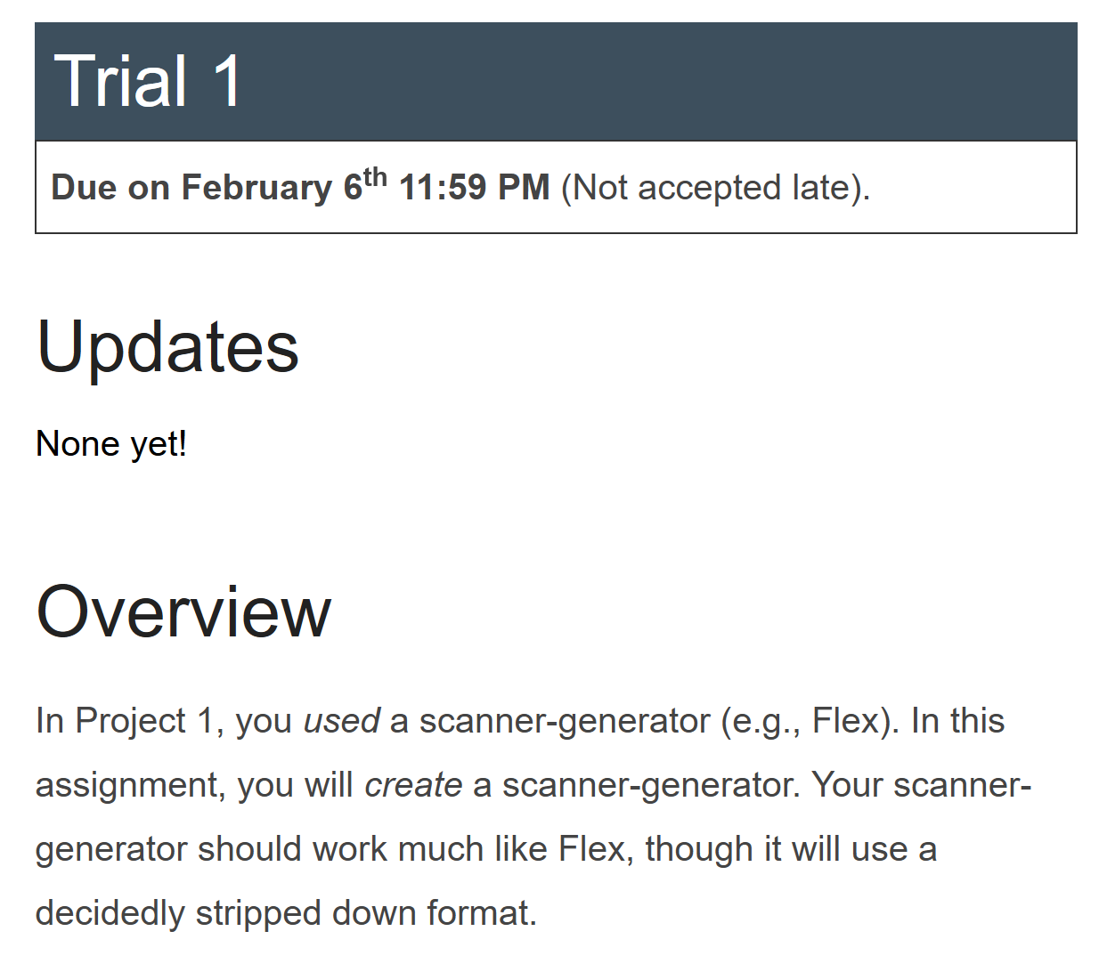
Administrivia
Behold: The Dragon Trials!
https://compilers.cool/trials/t1

Slide 6
Flipped Wednesday

Slide 7
Written Work #1
Topics:
Compiler Overview

Slide 8
Written Work #1: Question 1
What is the purpose of the lexer component of a compiler? Give an example of an input that GCC would flag for a lexical error.

Slide 9
Written Work #1: Question 2
What is the purpose of the syntactic analysis component of a compiler? Give an example of an input that GCC would flag for a syntactic error.

Slide 10
Written Work #1: Question 3
What is the purpose of name analysis in a compiler? Give an example of an input that GCC would flag for failing name analysis.

Slide 11
Written Work #1: Question 4
What is the purpose of type analysis in a compiler? Give an example of an input that GCC would flag for failing type analysis.

Slide 12
Example Parse Tree for Grammar

