Slide 1
Announcements Administrivia
Quiz 3 and Quiz 4 to be returned on Wednesday

Slide 2
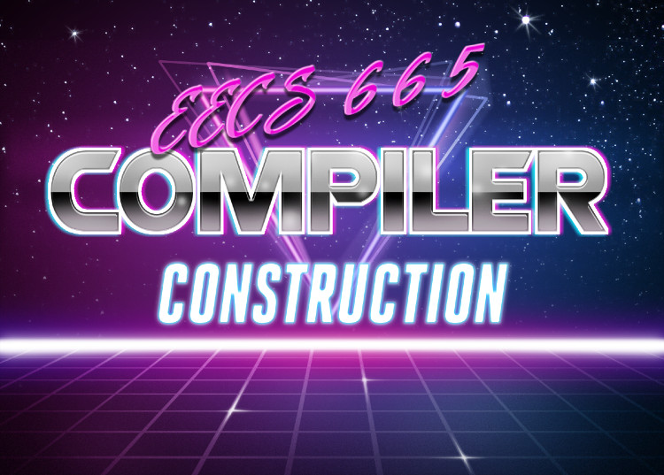
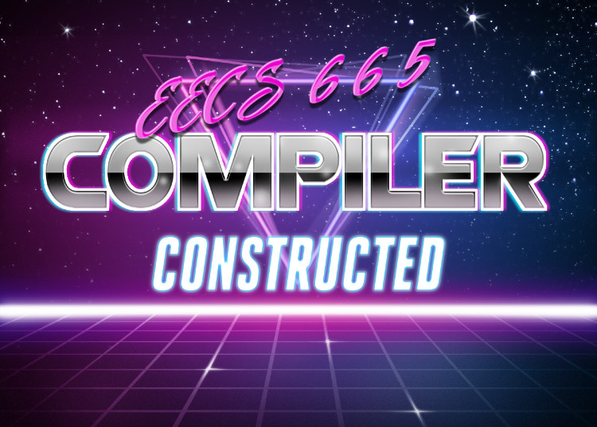
Partial Evaluation

Slide 3
Today’s Lecture Partial Evaluation
Partial Evaluation
What it is
How to do it
The Futamura projections
Advanced Topics

Slide 4
Partial Evaluation Partial Evaluation - Background
Disclaimer: the fun-sized introduction to a complex topic
There are whole books on this technique!
( https://compilers.cool/materials/JonesPartialEvaluation.pdf )

Slide 5
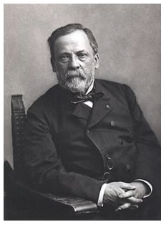
Compiler Philosophy About Partial Evaluation - Background
More static work means less dynamic work
Optimize programs to run better
Flag (potential) bugs before they bite
“Fortune favors the prepared”
- Louis Pastuer

Slide 6
Compiler Philosophy - Consequence About Partial Evaluation - Background
We can only optimize what we can prepare for
int a = atoi(argv[1]);
int y = atoi(argv[2]);
int x;
if (y < 3){
x = (4 * (7 * (2 + (3 * a))));
} else {
x = 1;
}
A tasty target for
optimization…
blocked by a pesky
dynamic value!

Slide 7
Partial Evaluation: Concept Partial Evaluation
“Drew”
We often use the same value for some of the arguments to the program
What if we could take those values for granted?
Specialize programs for “guaranteed” inputs
bool cool(bool age, char * name){
size_t len = strlen(name);
if (isPrime(len)){
return false;
} else {
return age < 30;
}
}
4
How I run this program:
cool(27, “Drew”) -> true
cool(28, “Drew”) -> true
cool(29, “Drew”) -> true
cool(30, “Drew”) -> false
cool(31, “Drew”) -> false
cool(32, “Drew”) -> false

Slide 8
Partial Evaluation: “Specialization” Partial Evaluation
Create special versions of a program
Less general than the original program
More efficient on what it does do

Slide 9
Dividing Input Partial Evaluation: Concept
Split input into two groups
Some inputs constant, the rest dynamic
Static Input
Dynamic Input
Input

Slide 10
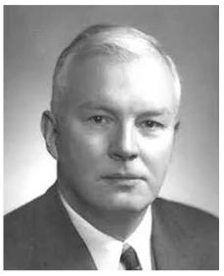
“This is Kinda Like Currying!” Partial Evaluation: Concept
Yep, it is!
Haskell Curry, after whom Currying and the Haskell language are named

Slide 11
“This is Kinda Like Currying!” Partial Evaluation: Concept
Yep, it is!
Some differences:
PE not constrained to function level
PE can perform arbitrary combinations of arguments
Uncurried
function
Curried
function
$$f :\left(x,y\right)→z$$
$$f :x→(y→z)$$
minus
a as 5
int minus(int b){ 5 - b;
}
int minus(int a, int b){ a - b;
}
minus
int minus(int a){ a - 5;
}
int minus(int a, int b){ a - b
}
b as 5

Slide 12
Today’s Lecture Partial Evaluation
Partial Evaluation
What it is
How to do it
The Futamura projections
Advanced Topics

Slide 13
Simplistic Implementation Intuition Partial Evaluation - Technique
Analyze every program path
If dynamic data can influence it, don’t alter the code
If multiple values can touch it, account for all possibilities
If value is static, replace with result (like constant folding)!
Dynamic
Static
“Drew”
bool cool(bool age, char * name)
{
size_t len = strlen(name);
if (isPrime(len)){
return false;
} else {
return age < 30;
}
}
bool cool_nameIsDrew(bool age)
{
size_t len =
if (isPrime(len)){
} else {
return age < 30;
}
}
“Drew”
4
;
4

Slide 14
Implementation – Dataflow Approach Partial Evaluation - Technique
Propagate dynamic values
Leave dynamic-dependent code alone
Evaluate purely-static code paths
enter cool
getarg 1, [age]
getarg 2, [name]
setarg 1, [name]
call strlen
[name] := “Drew”
“Drew”
getret 1, [len]
setret 1, [len]
call isPrime
4
4
getout 1, [tmp1]
ifz [tmp1] goto L_1
false
bool cool(bool age, char * name)
{
size_t len = strlen(name);
if (isPrime(len)){
return false;
} else {
return age < 30;
}
}
jmp
setret 0
L_1:
[tmp2] := [age] < 30
setout [tmp2]
jmp
L_2:
leave

Slide 15
Partial Evaluation as Compiler Pass Partial Evaluation - Technique
Could implement partial evaluation as an optimization module
Recompile program with your guaranteed values
(e.g. name)
(e.g. prog.c)
Static Input
Source code
Front end
Middle end
Back end
Partial Evaluation
(e.g. age.exe)
Dynamic Input
Specialized
(e.g. prog.exe)
Program

Slide 16
Partial Evaluation as Compiler Pass Partial Evaluation - Technique
Source code
Static Input
Dynamic Input
Front end
Middle end
Turns generic executable into specialized executable
Back end
Specializer
Program
Partial Evaluation
Specialized
Program

Slide 17
The Specializer Partial Evaluation - Technique
Source code
Static Input
Dynamic Input
Front end
Let’s reorganize these components a bit…
Middle end
Turns generic executable into specialized executable
Back end
Specializer
Program
Partial Evaluation
Specialized
Program

Slide 18
The Specializer Partial Evaluation - Technique
Static Input
Executable
Program
Specializer takes:
An executable program
A static input-subset
Specializer outputs:
An executable
Specializer
Partial Evaluation
Heavyweight
offline phase
Lightweight
offline phase
Dynamic Input
Specialized
Program

Slide 19
The Specializer: Example Partial Evaluation - Technique
Assume we frequently need to know text statistics of War and Peace

Slide 20
The Specializer: Example Partial Evaluation - Technique
Assume we frequently need to know text statistics of War and Peace
How many lines of text?
How many words?
How many characters?
Assume we run these commands a lot
options change
text is static
wc –l war_and_peace.txt
wc –w war_and_peace.txt
wc –c war_and_peace.txt
wc –w war_and_peace.txt
wc –l war_and_peace.txt
wc –w war_and_peace.txt

Slide 21
The Specializer: Example Partial Evaluation - Technique
Assume we frequently need to know text statistics of War and Peace
Static Input
Executable
Program
wc
war_and_peace.txt
This program does text counts on any input file
This program does text counts only on War and Peace
but
(presumably) faster than the generic wc
Specializer
Partial Evaluation
Heavyweight
offline phase
Lightweight
online phase
Dynamic Input
Specialized
Program
option (e.g. –l, -c, -w)
wc_warAndPeace

Slide 22
Specializer Optimization Targets Partial Evaluation
Pattern recognition
Ray tracing of solid models
Neural network training
Database queries
Spreadsheet computations
Scientific computing
Discrete hardware simulation

Slide 23
Other Uses of Specialization Partial Evaluation – Futamura Projections
A (perhaps obvious) observation:
Some programs take other programs as input
What if we used specialization as part of the program transformation process?
This observation leads to some startling results

Slide 24
Today’s Lecture Partial Evaluation
Partial Evaluation
What it is
How to do it
The Futamura projections
Advanced Topics

Slide 25
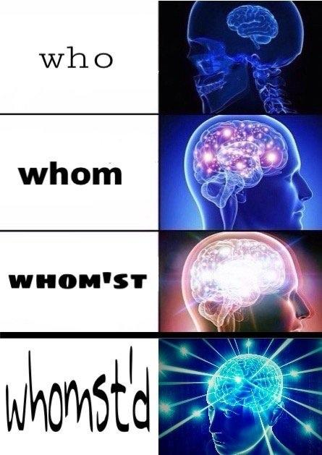
The Futamura Projections Partial Evaluation – Futamura Projections
Baseline specialization
(not a Futamura Projection)
1st Futamura Projection
2nd Futamura Projection
3rd Futamura Projection

Slide 26
Baseline Specialization Partial Evaluation – Futamura Projections
Specialize a program on some of its input
Static Input
Executable
Program
wc
war_and_peace.txt
Specializer
Partial Evaluation
Heavyweight
offline phase
Lightweight
offline phase
Specialized
Program
wc_warAndPeace

Slide 27
1st Futamura Projection Partial Evaluation – Futamura Projections
Specialize an interpreter on program code
Static Input
Executable
Program
interpreter
Program source code
Specializer
Partial Evaluation
Heavyweight
offline phase
Lightweight
offline phase
Specialized
Program
Executable
“compiled code”

Slide 28
2nd Futamura Projection Partial Evaluation – Futamura Projections
Specialize the specializer on the interpreter code
Static Input
Executable
Program
Specializer
Interpreter
Specializer
Partial Evaluation
Heavyweight
offline phase
Lightweight
online phase
Specialized
Program
Compiler

Slide 29
3rd Futamura Projection Partial Evaluation – Futamura Projections
Specialize the specializer on the interpreter code
Static Input
Executable
Program
Specializer
Interpreter
Specializer
Partial Evaluation
Heavyweight
offline phase
Lightweight
online phase
Specialized
Program
Compiler-Compiler

Slide 30
The Futamura Projections Partial Evaluation – Futamura Projections
Baseline specialization
(not a Futamura Projection)
1st Futamura Projection
Specialize interpreter on a program
Use specializer as a (slow) compiler
2nd Futamura Projection
Specialize specializer on interpreter
Use specializer to (slowly) build a compiler
3rd Futamura Projection
Specialize specializer on specializer
Use specializer to build a program that builds compilers

Slide 31
The Futamura Projections Partial Evaluation – Futamura Projections
Baseline specialization
(not a Futamura Projection)
1st Futamura Projection
Specialize interpreter on a program
Use specializer as a (slow) compiler
2nd Futamura Projection
Specialize specializer on interpreter
Use specializer to (slowly) build a compiler
3rd Futamura Projection
Specialize specializer on specializer
Use specializer to build a program that builds compilers

Slide 32
Futamura Projections: WTF? Partial Evaluation – Futamura Projections
Why would you do this?
Reduces Effort
Interpreters are nice! So are compilers!
You want both, you can get both by just building interpreters
Is this real?
Satisfying the definitions is easy
Making good specialized programs is not

Slide 33
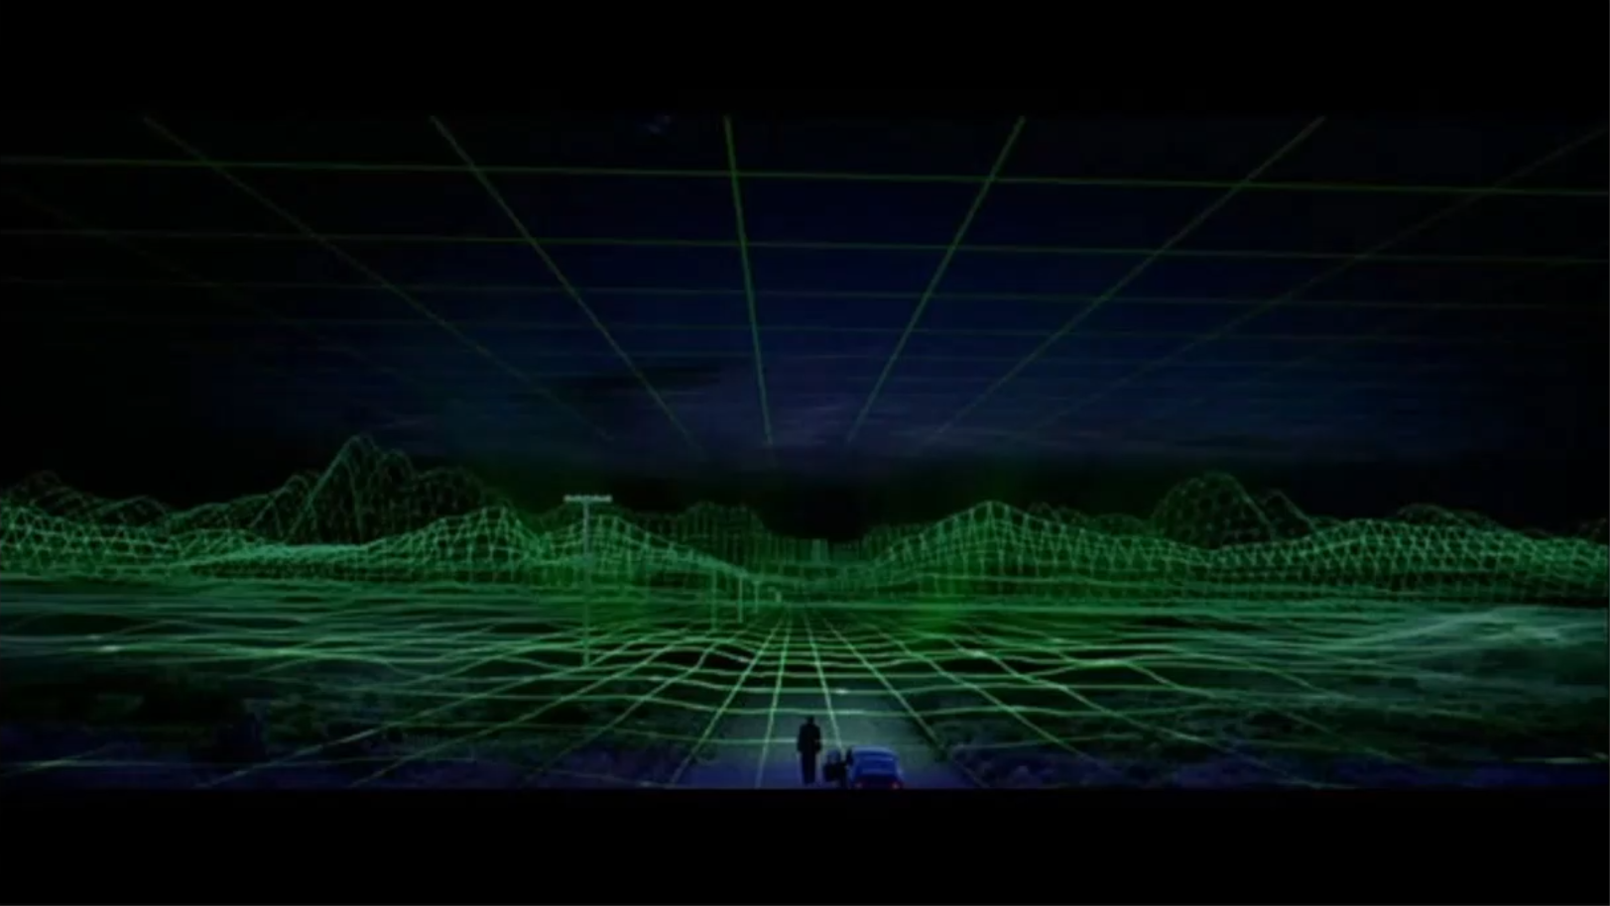
Another Frontier in Computer Science Partial Evaluation – Futamura Projections

Slide 34
End of Lecture: Summary Partial Evaluation – Futamura Projections
Summary
Specialize program to enable optimization
Treat some input as static, some as dynamic
Powerful technique with ability to repurpose compiler components

Slide 35
Next Time: Beyond Compilers Lecture Preview
Using the tools and techniques that build compilers for things other than building compilers

