Slide 1
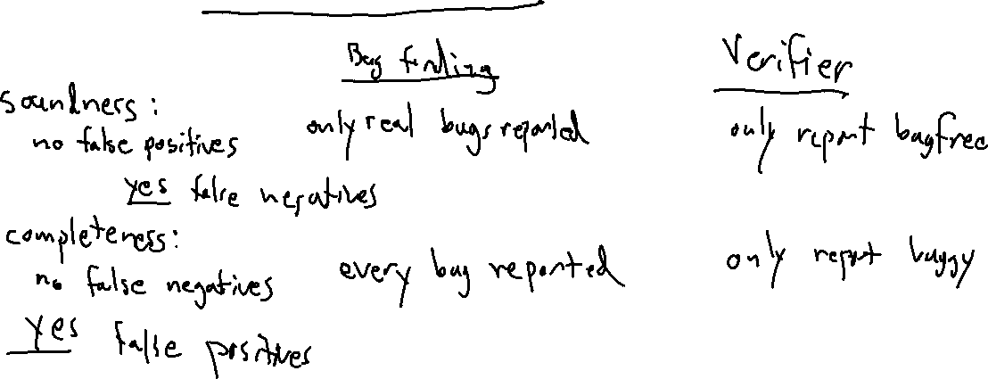
Check-in
Give an example of a bug-finding program analysis method which is sound but not complete.

Slide 2
Flipped Wednesday

Slide 3
Administrivia
P4 deadline finally updated on compilers.cool, Canvas soon
Midpoint survey time!

Slide 4
Written Work #5
Topics:
SLR Parsers
Scope
Semantic Analysis

Slide 5
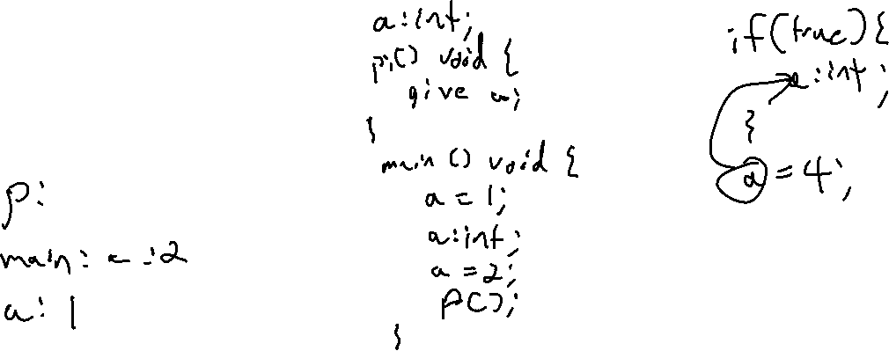
Written Work #5: Question 1
Recall that Drewno Mars is a statically-scoped language. Assume a new variant of Drewno Mars, called Bruno Davidson, that uses the exact same syntax as Jeff but is dynamically-scoped. Provide an input file that would be valid in both Drewno Mars or Bruno Davidson, but prints a different result based on which scoping system is used. Show what the output would be either under scheme.

Slide 6
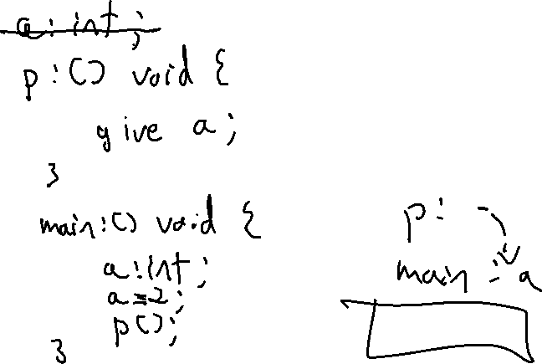
Written Work #5: Question 2
Provide an input file that would be valid in Bruno Davidson, but not in Drewno Mars.

Slide 7
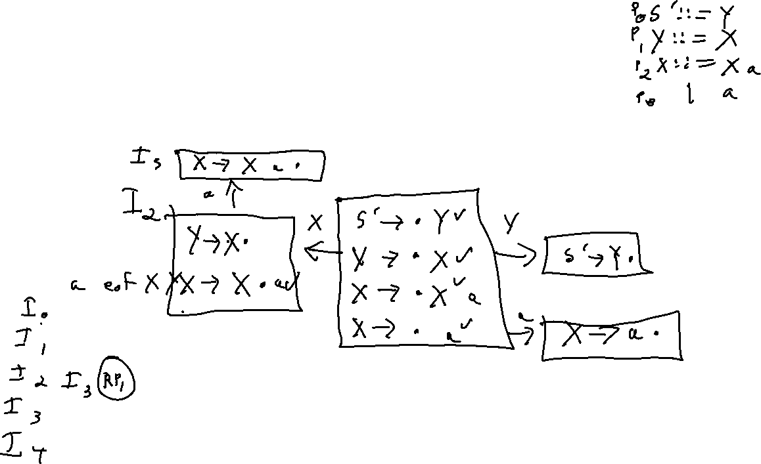
Written Work #5: Question 3
Explain the difference between an SLR and an LR(0) parser. Provide an example grammar that is SLR-parseable but not LR(0) parseable.

Slide 8
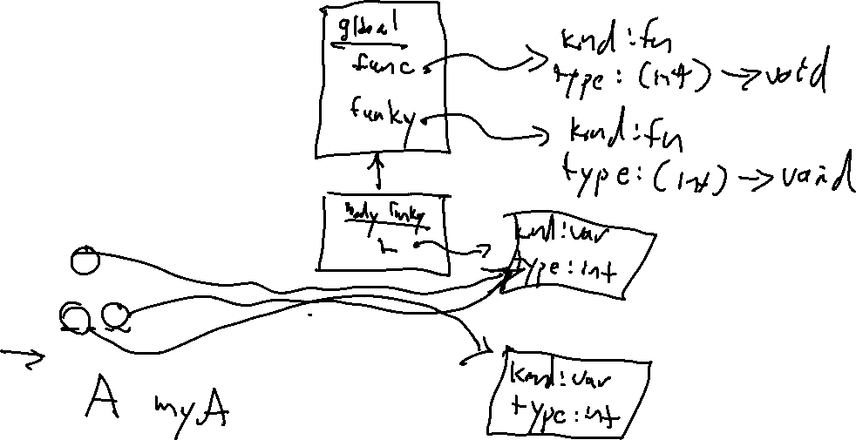
Written Work #5: Question 4
Draw the symbol table at the point in name analysis after line 11 but before line 12.
1. void func(int arg){
2. int a;
3. }
4. void funky(int arg){
5. int l;
6. if (l > 2){
7. int m;
8. m = l;
9. }
10. if (l < 2){
11. int n;
12. n = l;
13. }
14. }

Slide 9
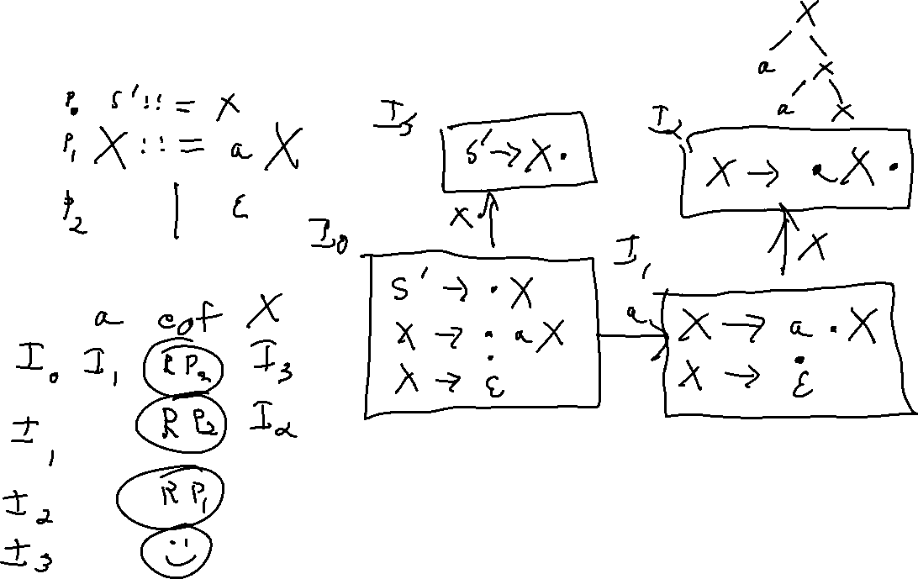
SLR with epsilon

