Slide 1
Check-In Review – Type Checking
Assume a program snippet has generated the following AST. Annotate each node with the type it corresponds to (or error if it is an error type). If a type analysis would issue a report, indicate that as well.
1
[ ]
1
2
2
5
3
VarDecl
AssignStmt
4
3
4
6
7
IntType
ID
ID
LessThan
5
name: b
name: b
6
symbol: *1
symbol: *1
7
8
9
ID
Times
8
name: b
symbol: *1
9
10
11
10
ID
IntLit
name: b
value: 4
11
symbol: *1

Slide 2
Administrivia Housekeeping
Check-in
Accidentally listed as a freebee?
Exam 2
Friday of next week

Slide 3
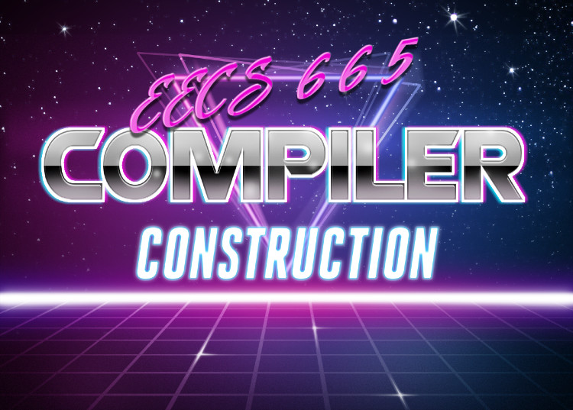
Error Reporting
University of Kansas | Drew Davidson

Slide 4
Last Time Lecture Review – Type Analysis
You Should Know
The meaning of different aspects of type systems
The simple AST-based type analysis
How to propagate type errors
Types
What they are
Why we have them
Type Rules
Examples
Connecting operations to their types
Enrich our static analysis pass
Semantics

Slide 5
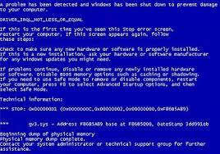
Handling Errors Type Analysis – Implementing Type Checking
We’d like all distinct errors at the same time
Don’t give up at the first error
Don’t report the same error multiple times
When you get error as an operand
Don’t (re)report an error
Again, pass error up the tree

Slide 6
Type Error Example Type Analysis – Implementing Type Checking
int a;
bool b;
a = true + 1 + 2 + b;
b = 2;
StmtList
AssignStmt
AssignStmt
error
REPORT
error
AssignExp
AssignExp
int
error
bool
int
IdNode
Plus
REPORT
IdNode
IntLit
symbol
bool
error
type: int
name: a
Plus
IdNode
symbol
symbol
error
int
REPORT
Plus
IntLit
2
type: bool
name: b
bool
int
BoolLit
true
IntLit
1

Slide 7
Today’s Outline Lecture Overview – Error Reporting
Error Checking
What counts as a bad program?
How do we detect bad programs?
Limits of Analysis
The halting problem
Semantics

Slide 8
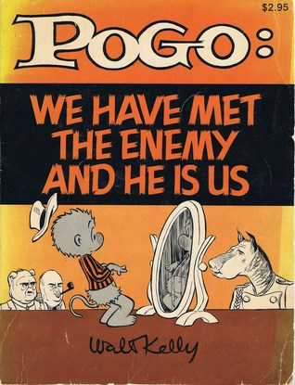
Error Checking Semantic Analysis
Goal: save programmers from themselves
It’s not enough to compile the programmer’s code
Need to figure out what programmer meant to code

Slide 9
Quick Audience Poll Semantics – Error Checking
Does this C program compile?
Should this C code compile?
int a = 0;
int main(){
if (0 == 1){
b = 6;
}
return a; }

Slide 10
A Compiler’s Error-Checking Obligation Semantics – Error Checking
Understandability / Consistency

Slide 11
Compiler As Mind Reader Semantic Analysis – Broad View
A machine that infers your intent

Slide 12
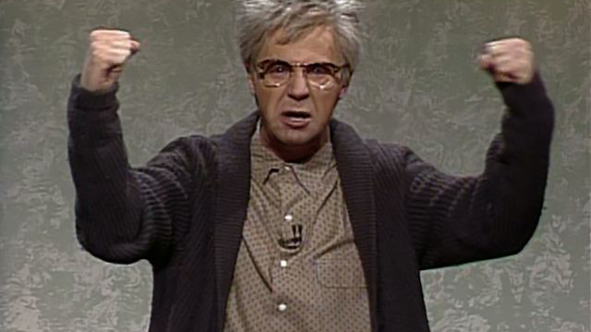
Compiler as Complainer Semantic Analysis – Broad View
A grumpy old man that yells at you for breaking the rules

Slide 13
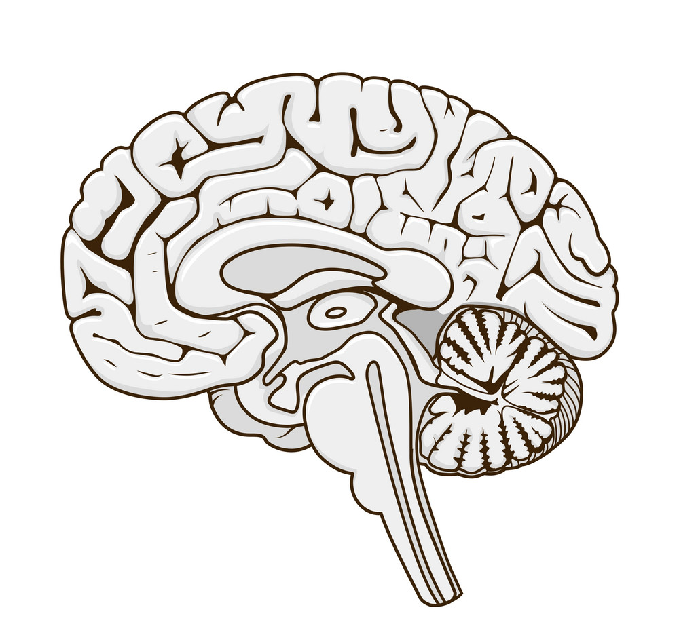
The Compiler Before the Compiler Semantic Analysis – Broad View
Semantic gap: difference between the description of the same object in two different representation

Slide 14
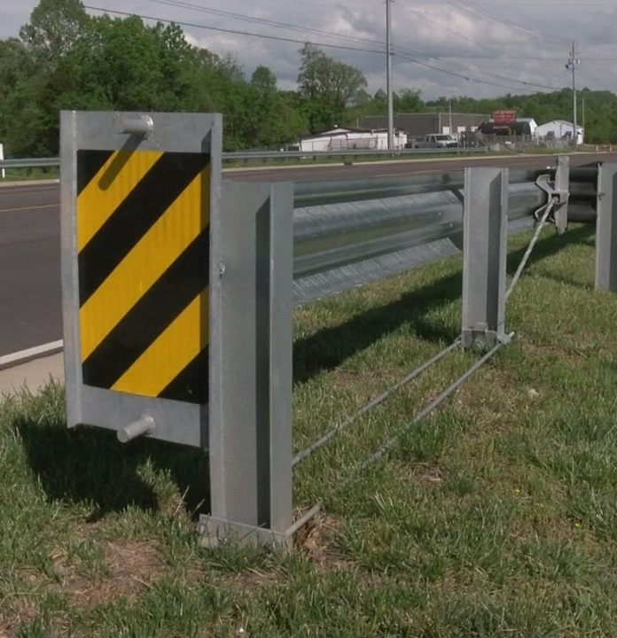
Bug Hunting Semantic Analysis – Broad View
How do we prevent nonsense code from executing?
We’ll consider two ways of analysis:
Static
Dynamic
Putting guardrails on computation

Slide 15
Compiler Perspective Semantic Analysis – Broad View
Static
Code analysis without execution
Dynamic
Code analysis through execution
Checks done at compile time
Analysis part of the compiler itself
Checks done at run time
Analysis embedded into the program

Slide 16
Compiler Focus: Static Analysis Semantic Analysis – Broad View
Doesn’t slow the program down
Ok to take longer
Ok to apply more heavyweight analysis
Has a “holistic” view of the program
Has access to source code
Knowledge of non-executed program paths

Slide 17
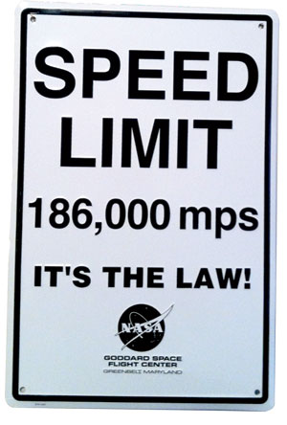
Limits of Error Checking Static Analysis
We’d LOVE to ensure bug-free programs
Observe and report bugs before they are encountered
Usually we can’t do this
Limits of static analysis

Slide 18
Limits of Static Analysis Static Analysis
Theoretical argument
Practical argument

Slide 19
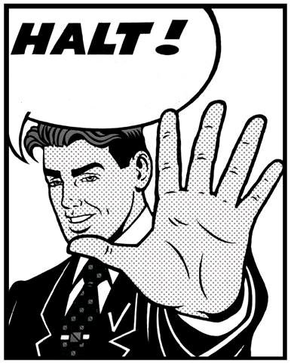
The Halting Problem Static Analysis
Does a computation ever terminate?
Given a description of a Turing machine and its initial input, determine whether the program, when executed on this input, ever halts (completes). The alternative is that it runs forever without halting

Slide 20
Sketching the Halting Problem Static Analysis
Effective procedure
a procedure that is always yields a correct result on any input
Any program
White Magic
Effective method for the halting problem would say:
Return “true” if the program halts on the given input
Return “false” if the program never halts on the given input
True:
Program halts
False:
Program spins

Slide 21
No Effective Method for Halting Static Analysis
Black Magic
assume white_magic(Function p)
returns true if p halts, false if p does not
Black Magic
White Magic
void black_magic(){
if white_magic(black_magic){
while true { }
}
}
Blackmagic halts
Blackmagic spins
spin
return
White Magic
True:
Program halts
False:
Program spins

Slide 22
Implications of the Halting Problem Static Analysis
What does this have to do with, say, a null pointer analysis?
No halting solution means no reachability solution
int * a = nullptr;
int main(){
if (a != nullptr){
*a = 1;
}
return a; }

Slide 23
Rice’s Theorem Static Analysis
“All non-trivial semantic properties of programs are undecidable”

Slide 24
Rice’s Theorem – Basic Idea Static Analysis – Limits of Error Checking
What does this have to do with, say, a null pointer analysis?
No halting means no reachability
int main(){
if (black_magic()){
int * p = 0;
*p = 42;
} else {
return 0;
}
}

Slide 25
Rice’s Theorem - Implications Static Analysis – Limits of Error Checking
We’d like to perfectly capture all bugs
We can’t be right all of the time
We can choose HOW we are wrong

Slide 26
Limits of Static Analysis Static Analysis
Theoretical argument
Practical argument
What if we only consider the universe of programs not written by *$%!-heads?
(bleep)

Slide 27
Practical Argument Static Analysis
It’s really hard!

Slide 28
Let’s do some Sciency-Sounding Stuff Static Analysis - Evaluation

Slide 29
Evaluating a Bug Detector Static Analysis - Evaluation
True
False
Has report
Has report
Has bug
No bug
Positive
report
bug
Correct
Type I
Error
No report
No report
No bug
Has bug
Negative
Type II
Error
No bug
report
Correct
Analysis is correct
Analysis is wrong

Slide 30
Guarantees Under Imperfect Detection Static Analysis – Limits of Error Checking
Consistency / Reliability super important for users
We’d like to limit the kinds of errors we report
We can choose which type of bug report error to avoid
Soundness: No false positives
Completeness: No false negatives

Slide 31
Visual Analogy Static Analysis – Limits of Error Checking
Reported
bugs
Imagine the universe of all programs is contained in a circle
You can draw a circle around the programs you report as buggy
The actual buggy programs occupy a jagged region
All Programs
Buggy programs

Slide 32
Soundness and Completeness Static Analysis – Limits of Error Checking
Reported
bugs
Reported
bugs
All Programs
All Programs
Buggy programs
False
Positive
Buggy programs
False
Negative
Sound bug detection
Complete bug detection
All correct programs pass through
(No false positive problem)
All buggy programs get flagged
(No false negative problem)
Some buggy programs pass through
(has false negative problem)
Some correct programs get flagged
(has false positive problem)

Slide 33
Partial Correctness Static Analysis – Limits of Error Checking
Make best-effort procedures that are neither sound nor complete
We can analyze the result of a statement under certain assumptions
Assume that the statement is executed
Assume that the statement actually completes

