Slide 1
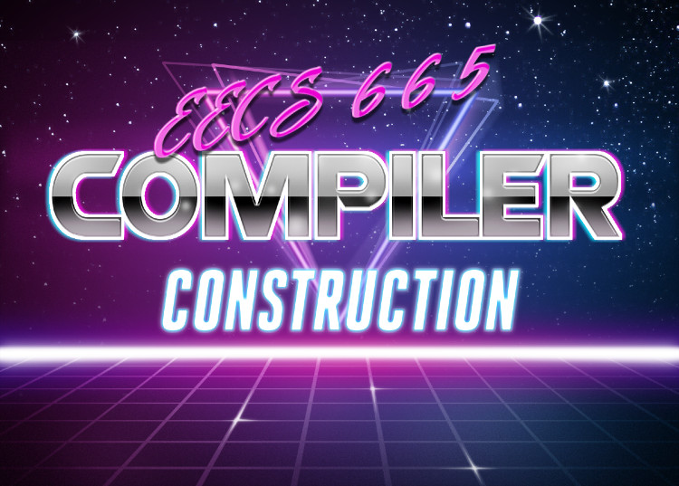
Parameters
University of Kansas | Drew Davidson

Slide 2
Compiler Construction: Progress You are here
Source code (sequence of chars)
Continuing exploration of language semantic features
Informs design/behavior of our semantic analysis
Scanner
Lexical analysis
Parser
Syntactic analysis
We are here
Semantic analysis
Intermediate code generation
IR optimization
Final Code generation
Final code optimization
Output code in T

Slide 3
Last Time Lecture Review – Error Checking
The Limits of Error Checking
Halting problem
Partial Correctness
Partial Correctness
Soundness
Completeness
Semantics

Slide 4
Today’s Outline Parameters
Vocabulary
lval/rval
Memory references
Calls
Parameter Passing
Call by value
Call by reference
Call by name
Call by value-result
Semantics

Slide 5
Vocabulary Parameters
Define a couple of terms that are helpful to talk about parameters
We already encountered some of these in passing

Slide 6
L and R Values Parameters
L-Value
A value with a place of storage
R-Value
A value that may not have storage
a = 1;
a = b;
b++;

Slide 7
Bad Use of R-Values Parameters
Can prevent programs that are valid in pass by value from working in pass by reference
Literals (for example) do not have locations in memory
The type checker should catch these errors.

Slide 8
Memory References Parameters
Pointer
A variable whose value is a memory address
Aliasing
When two or more variables reference the same address

Slide 9
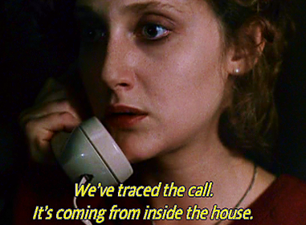
Calls Parameters
Caller
The source function initiating the call
Callee
The target function receiving the call
Call Site
The location within the caller where the call happens
caller

Slide 10
Calls Parameters
Caller
The source function initiating the call
Callee
The target function receiving the call
Call Site
The location within the caller where the call happens
void a(){
return;
}
void b(){
a(); }
void c(){
b();
a(); }
Here
b is the caller
a is the callee
Here
c is the caller
b is the callee
Here
c is the caller
a is the callee

Slide 11
Call Chains Parameters
Call Graph
A node-based representation of possible call structure
Edge: caller -> callee
Call chain
A realizable path of calls (c,b,a)
a
void a(){
return;
}
void b(){
a(); }
void c(){
b();
a(); }
b
c

Slide 12
Arguments Parameters
In definition:
void v(int a, int b, bool c) { … }
Terms
Formals / formal parameters / parameters
In call:
v(a+b,8,true);
Terms
Actuals / actual parameters / arguments

Slide 13
Parameter Passing Schemes Parameters
We’ll talk about some different varieties
Some of these are more used than others
Each has advantages / uses

Slide 14
Pass by Value Parameters
On function call
Values of actuals are copied into the formals
C and java always pass by value
void fun(int a){
int a = 1;
}
void main(){
int i = 0;
fun(i);
print(i); }

Slide 15
Pass by Reference Parameters
On function call
The address of the actuals are implicitly copied
void fun(int a){
a = 1;
}
void main(){
int i = 0;
fun(i);
print(i); }

Slide 16
Language Examples Parameters
Pass by value
C, Java, C#
Pass by reference
Allowed in C++ and Pascal

Slide 17
Java and C# Are Pass by Value?! Parameters
All non-primitive L-values are references
void fun(int a, Point p){
a = 0;
p.x = 5;
}
void main(){
int i = 0;
Point k = new Point(1, 2);
fun(i,k); }

Slide 18
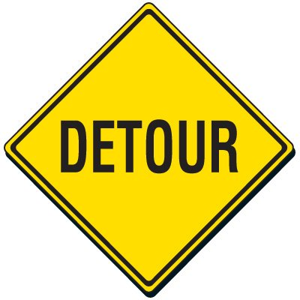
Pass by Value-Result Parameters
When function is called
Value of actual is passed
When function returns
Final values are copied back to the actuals
Used by Fortran IV, Ada
As the language examples show, not very modern

Slide 19
Pass by Name Parameters
Conceptually works as follows:
When a function is called
Body of the callee is rewritten with the text of the argument
Only really makes sense with non-local scope rules
Like macros in C / C++

Slide 20
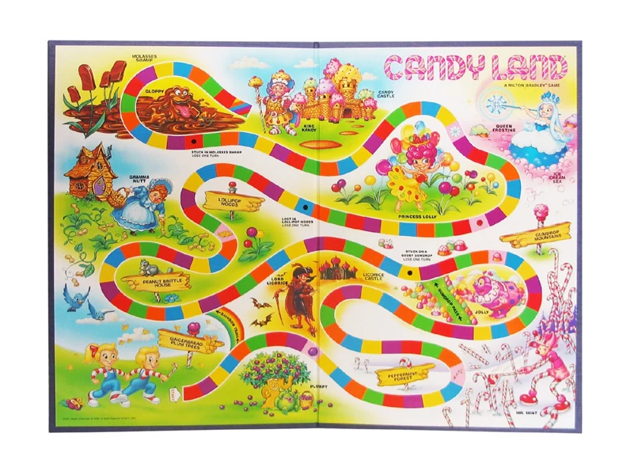
COMPILER
Optimization
Execution
Codegen
Intermediate
Representation
Runtimes
SDD
Parsing
Semantics
Lexical Analysis
Syntactic
Definiton

