Slide 1
Check-In Scope Review
Does this program compile in a static scoping scheme? In a dynamic scoping scheme? What is the output for each scheme in which it compiles?
a : int;
v : () void {
a = a + 1;
give a;
}
w : () void {
a = 7;
v();
give a;
}
main : () void {
int a;
w();
give a;
}

Slide 2
Semantic Analysis
University of Kansas | Drew Davidson

Slide 3
Announcements Administrivia

Slide 4
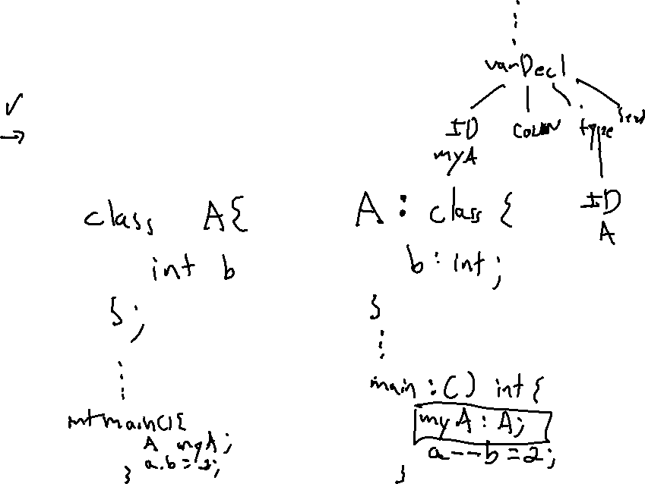
Announcements Administrivia
P3 Questions
- The POSTDec operator
- The MAGIC operator
- Class-type variables and declarations

Slide 5
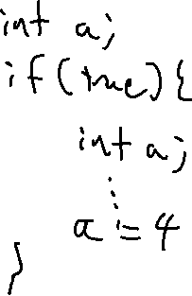
Last Lecture Lecture Review – Scope
Issues of Scope
Scheme
Shadowing
Overloading
You Should Know
Scope properties
How scope affects semantics
High-level scope rules for our language
Semantics

Slide 6
Lecture Outline Lecture Overview – Semantic Analysis
Name Analysis
Enforcing scope
Symbol Table
What it is
What it does
Semantics

Slide 7
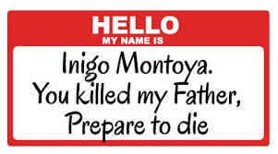
Name Analysis Semantic Analysis
Idea:
Associates IDs with their uses in the program
i.e. Emplace symbol table entries
Implemented as an AST pass
Purpose:
Needed for code generation
Catch some obvious errors
(undeclared IDs)

Slide 8
Recognizing Identifier Context Semantic Analysis
A node needs information from outside of its subtree
The definition of a identifiers needs to be connected to its occurrences
We need a data structure to propagate such context
A Context-Free Grammar is… context free
There’s lots of ways to do this!
We’ll just cover 1 way

Slide 9
The Compiler’s Symbol Table Semantic Analysis
Repository of semantic symbol information
Populated during a walk of the AST
Propagates context-sensitive information
Program Snippet
if(true){
int a;
a = 1;
}
AST Snippet
IfStmt
true
[stmts]
Symbol
Table
add info
VarDecl
AssignStmt
int
ID
a
ID
a
IntLit
1
lookup
info

Slide 10
The Compiler’s Symbol Table Semantic Analysis
What’s in the symbol table:
Depends on the language
Kinds of entries we need:
Variable Declarations
Function Declarations
Program Snippet
if(true){
int a;
a = 1;
}
AST Snippet
IfStmt
true
[stmts]
Symbol
Table
add info
VarDecl
AssignStmt
int
ID
a
ID
a
IntLit
1
lookup
info

Slide 11
The Compiler’s Symbol Table Semantic Analysis
What’s in the symbol table:
Depends on the language
Kinds of entries we need:
Variable Declarations
Function Declarations
Class Declarations
Program Snippet
if(true){
int a;
a = 1;
}
AST Snippet
IfStmt
true
[stmts]
add info
VarDecl
AssignStmt
$$\left(\begin{aligned}Current \\ Scope\end{aligned}\right)$$
kind: var
type: int
int
ID
a
ID
a
IntLit
1
a |
lookup
info

Slide 12
Symbol Table: A “Snapshot” of Scope Types – Name Analysis
At any (static) program point
Symbol table shows what’s in scope
Symbol table shows which scope contains the entry
Implementation:
A list of hashmaps (1 map per scope)
Symbol table after line 4
Global Scope
kind: var
type: int
a |
v |
kind: fn
type: ()->void
v body Scope
1. int a;
2. void v(){ 3. if (a){
int b;
}
}
if stmt Scope
b |
kind: var
type: int

Slide 13
Symbol Table: Scopes “Sub-tables” Semantic Analysis - Name Analysis
Create one hashmap per scope
Symbol table after line 1
Symbol table after line 4
Global Scope
Code
Global Scope
1. int a;
2. void f(){ 3. int a;
4. int b;
5. }
kind: var
type: int
kind: var
type: int
a |
a |
f |
kind: fn
type: ()->void
Symbol table after line 5
Global Scope
F Body Scope
kind: var
type: int
kind: var
type: int
a |
a |
b |
kind: var
type: int
f |
kind: fn
type: () -> void

Slide 14
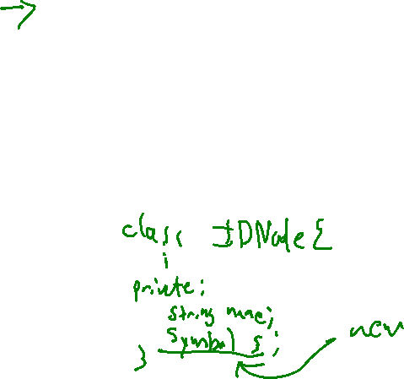
Implementation Semantic Analysis - Name Analysis
Walk the AST, much like the unparse() method
Augment AST nodes with a link to the relevant name in the symbol table
Build new entries into the symbol table when a declaration is encountered
Connect AST nodes to the entry they add or reference in the symbol table

Slide 15
Example Name Analysis
int b;
int f(int r){
int a;
if (true){
int b;
}
b = 1;
}
Program
[ ]
VarDecl
FnDecl
int
ID
b
int
ID
f
[ ]
[ ]
FormalDecl
Int
ID
r
IfStmt
VarDecl
AssignStmt
globals
b |
int
ID
a
true
[ ]
f |
name: f
kind: fn
type: (int) -> int
VarDecl
AssignExp
f body
name: b
kind: var
type: int
int
ID
b
r |
name: r
kind: var
type: int
ID
b
IntLit
1
a |
name: a
kind: var
type: int
mySymbol
if stmt
name: b
kind: var
type: int
b |
15

Slide 16
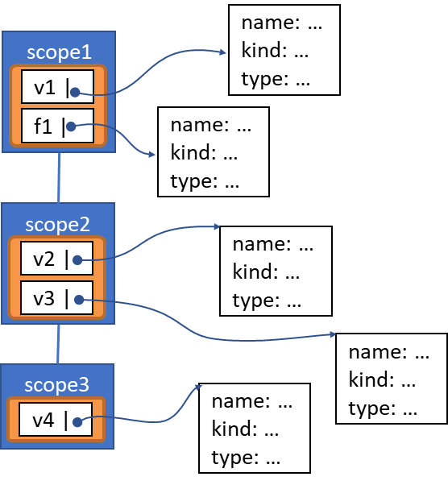
(My) Terminology Name Analysis - Implementation
Symbol Table – the whole structure
Scope Table – A single map
Symbol Table Entry (AKA “Semantic Symbol”)
name: …
kind: …
type: …
scope1
v1 |
f1 |
name: …
kind: …
type: …
scope2
v2 |
name: …
kind: …
type: …
v3 |
name: …
kind: …
type: …
scope3
name: …
kind: …
type: …
v4 |
name: …
kind: …
type: …
16

Slide 17
Implementation Suggestions Name Analysis - Implementation
Two approaches
A nameAnalysis method for each ASTNode subclass
Override as appropriate
The use of the visitor pattern
17

Slide 18
Example Name Analysis - Implementation
int b;
int f(int r){
int a;
if (true){
int b;
}
b = 1;
}
Program
[ ]
VarDecl
FnDecl
int
ID
b
int
ID
f
[ ]
[ ]
FormalDecl
Int
ID
r
IfStmt
VarDecl
AssignStmt
globals
b |
int
ID
a
true
[ ]
f |
name: f
kind: fn
type: (int) -> int
VarDecl
AssignExp
f body
name: b
kind: var
type: int
int
ID
b
r |
name: r
kind: var
type: int
ID
b
IntLit
1
a |
name: a
kind: var
type: int
mySymbol
if stmt
name: b
kind: var
type: int
b |
18

Slide 19
Summary Name Analysis – Wrap-Up
Described an analysis for enforcing static scoping
Demonstrated a way to implement the analysis as a walk over the AST
19

Slide 20
Next Time Name Analysis – Wrap-Up
Type Systems
What type systems are
Why we use them
The type system for our language
20

Slide 21
Scratch Page Name Analysis – Scratch
21

Slide 22
Scratch Page Name Analysis – Scratch
22

Slide 23
Scratch Page Name Analysis – Scratch
23

Slide 24
Scratch Page Name Analysis – Scratch
24

Slide 25
Scratch Page Name Analysis – Scratch
25

